Slide 1
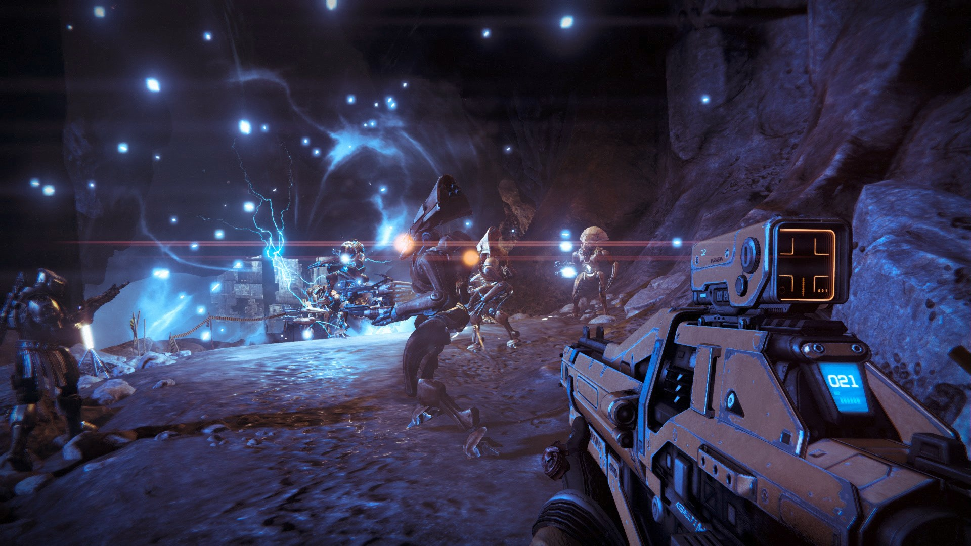

First Person Shooter

Slide 2
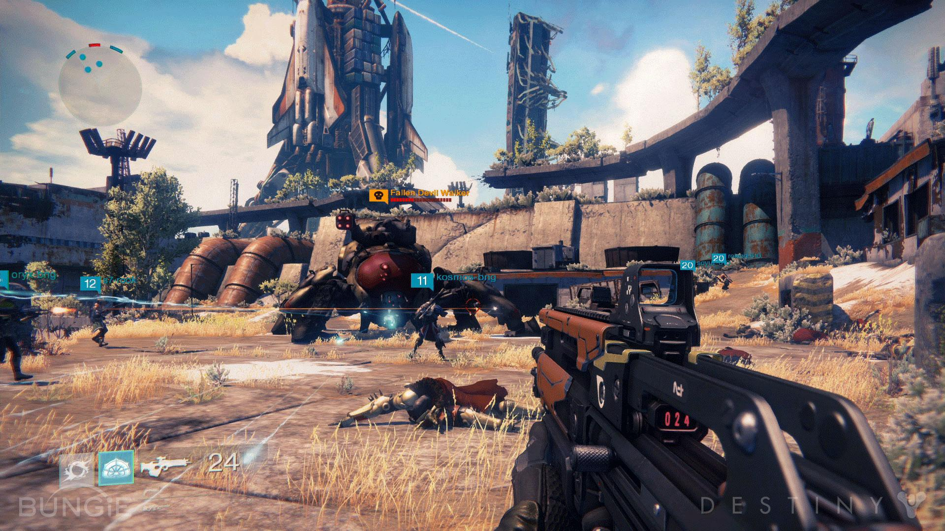


Slide 3
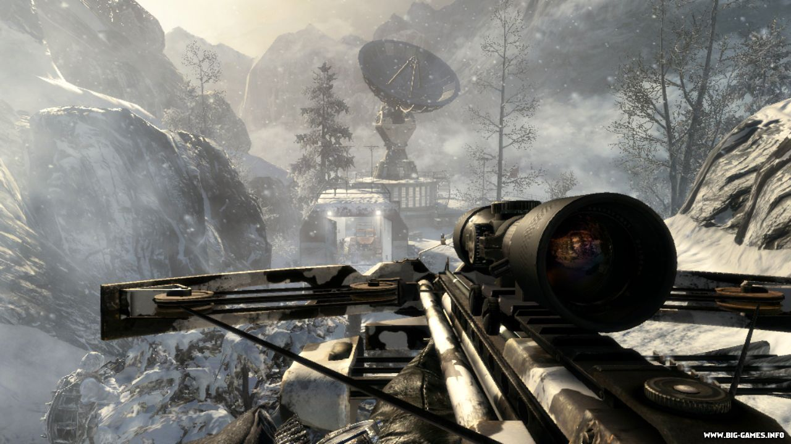

Slide 4
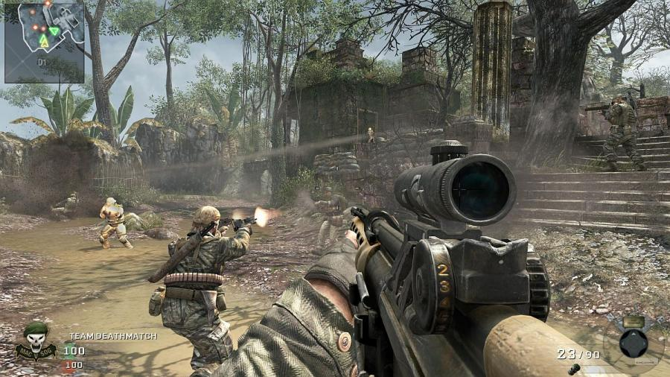

Slide 5
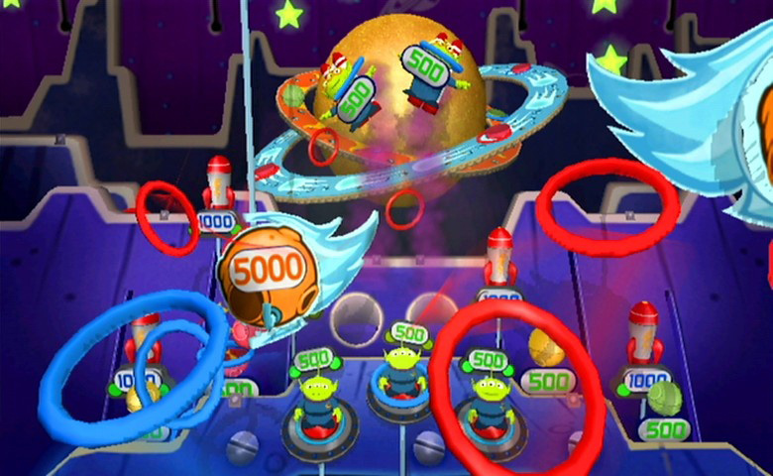
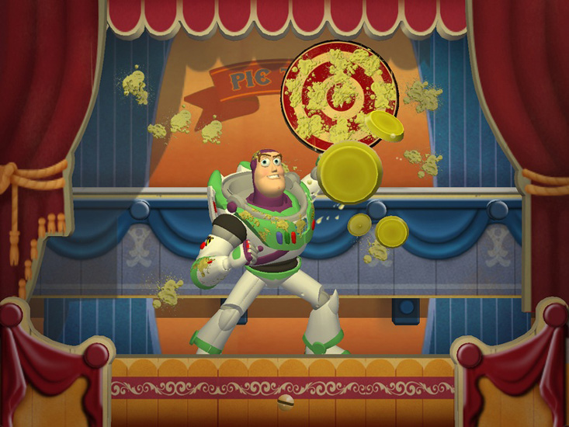
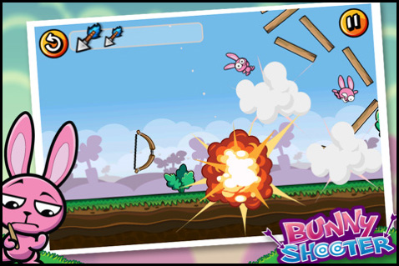

Slide 6
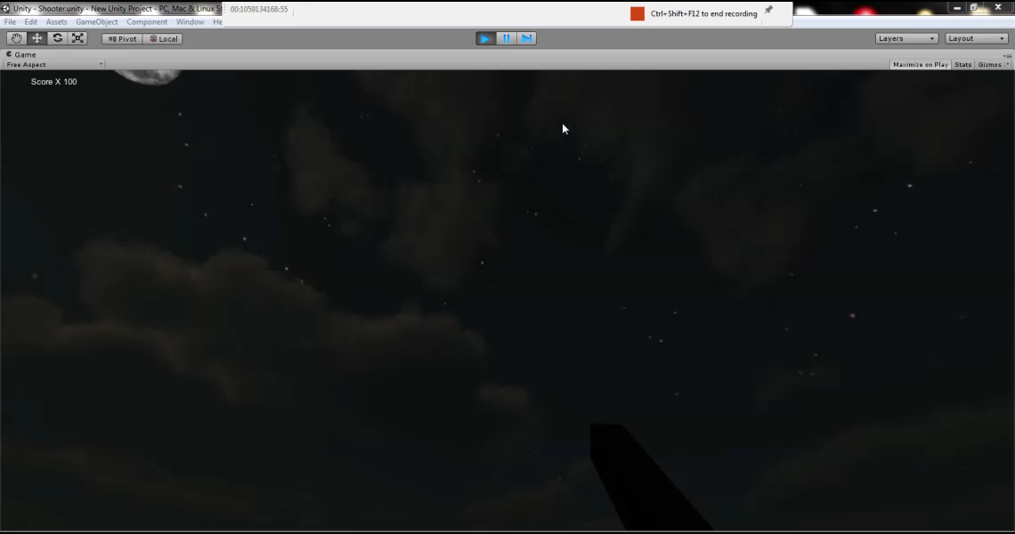

Slide 7
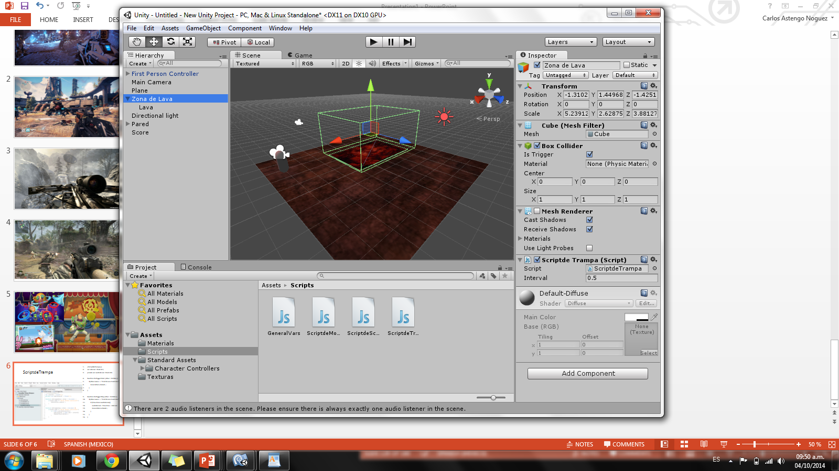
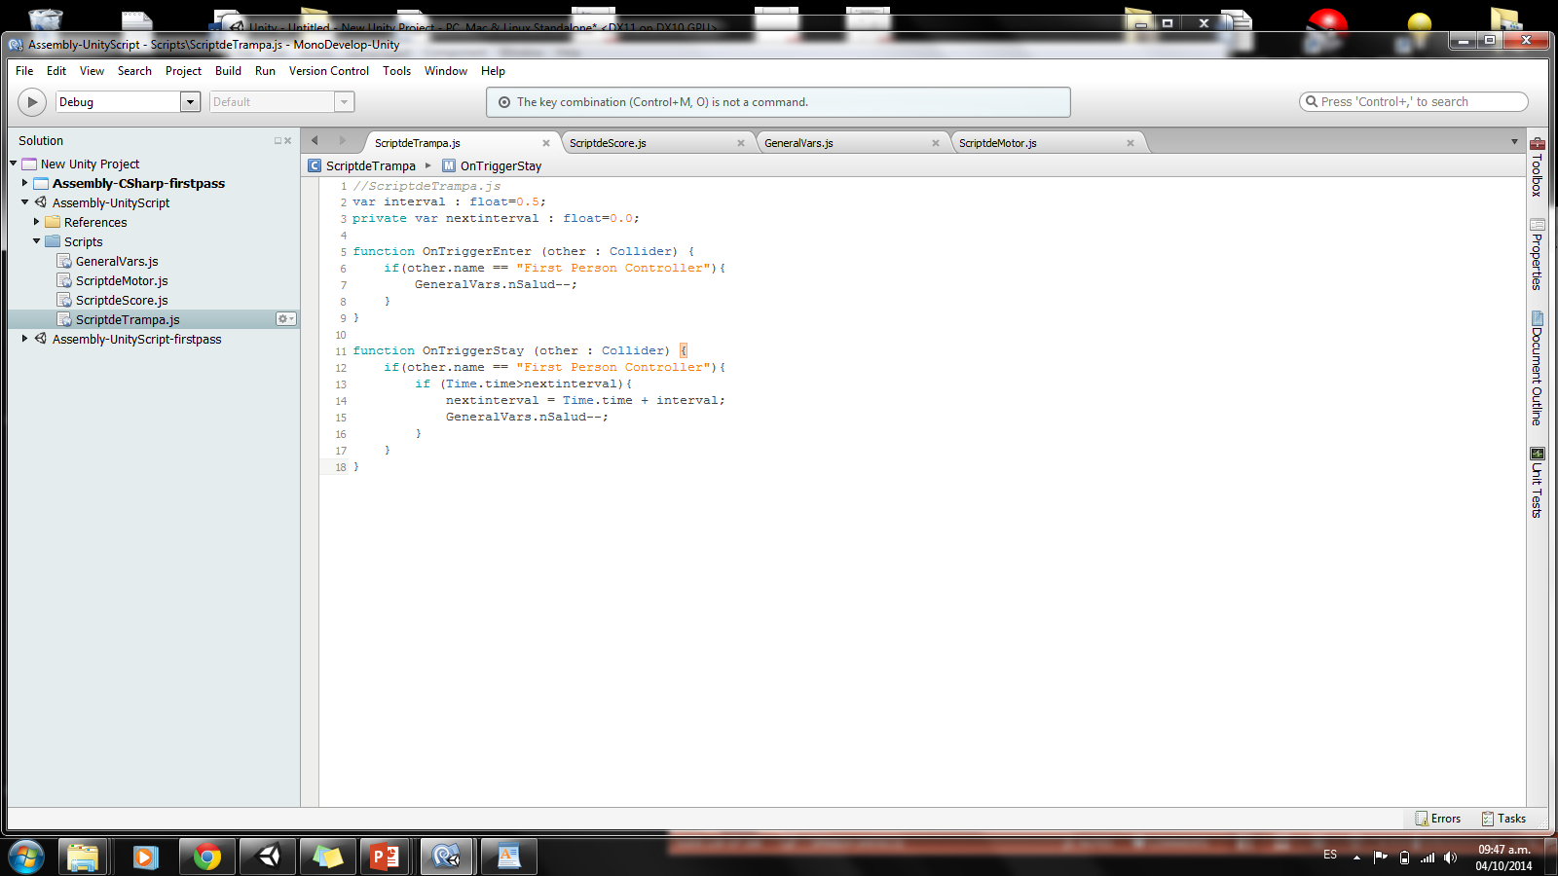
ScriptdeTrampa
//ScriptdeTrampa.js
var interval : float=0.5;
private var nextinterval : float=0.0;
function OnTriggerEnter (other : Collider) {
if(other.name == "First Person Controller"){
GeneralVars.nSalud--;
}
}
function OnTriggerStay (other : Collider) {
if(other.name == "First Person Controller"){
if (Time.time>nextinterval){
nextinterval = Time.time + interval;
GeneralVars.nSalud--;
}
}
}

Slide 8
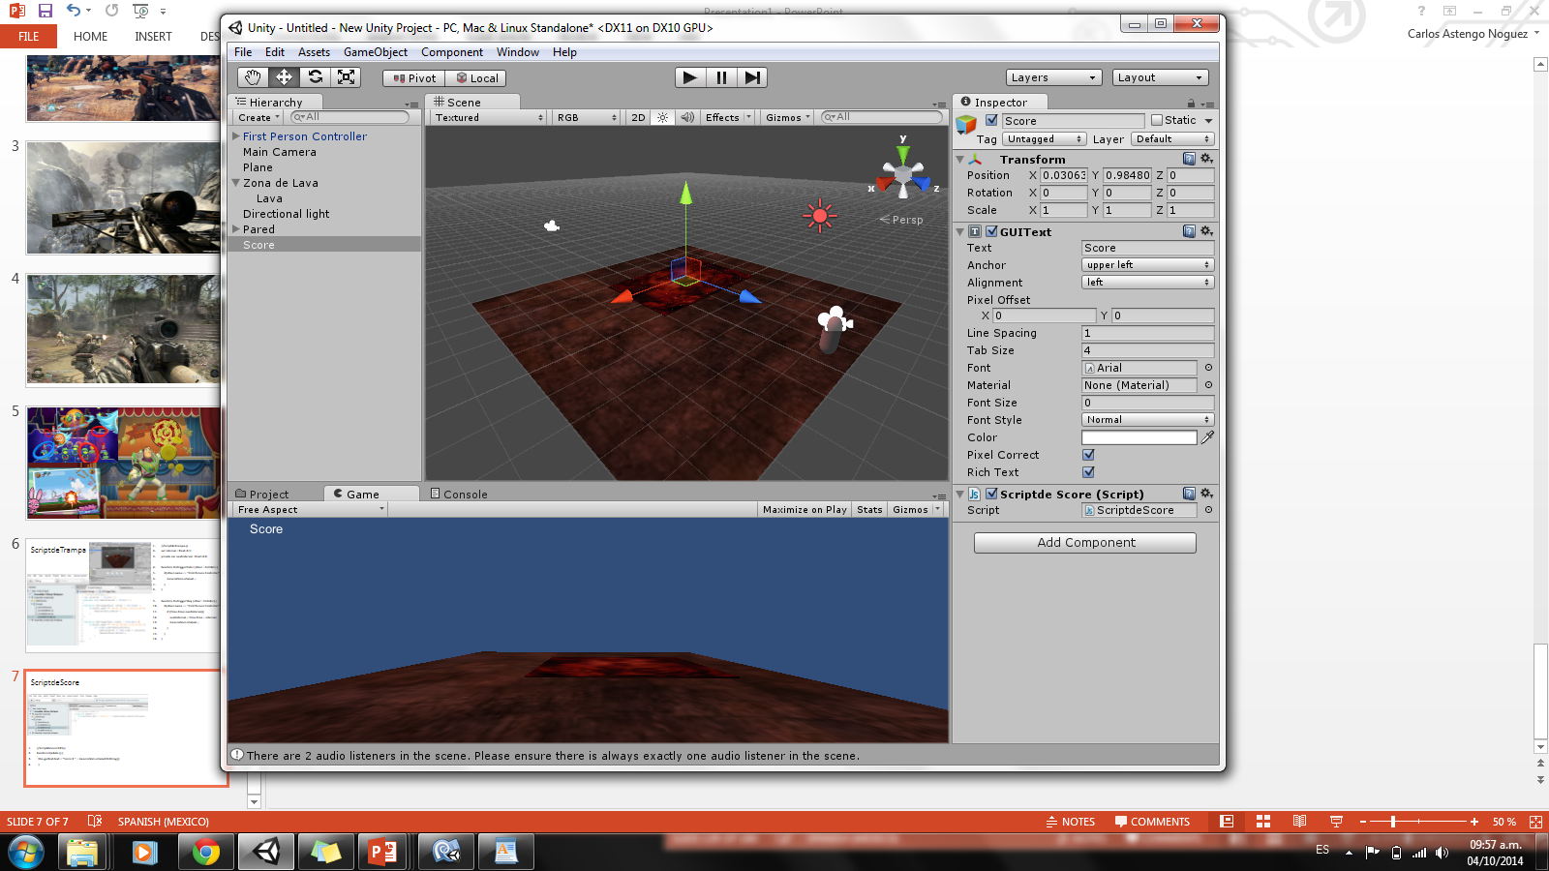
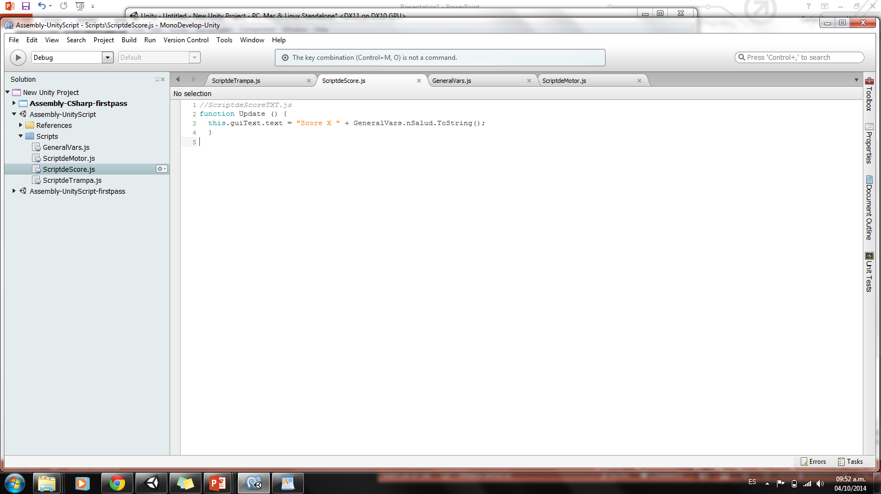
ScriptdeScore
//ScriptdeScoreTXT.js
function Update () {
this.guiText.text = "Score X " + GeneralVars.nSalud.ToString();
}

Slide 9
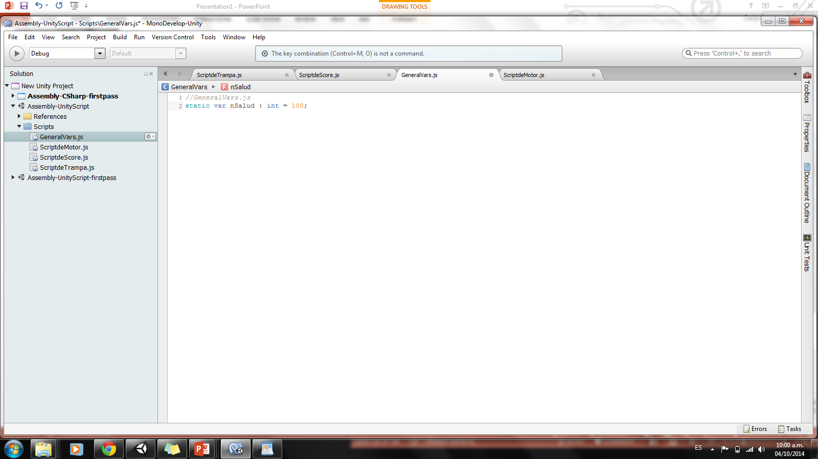
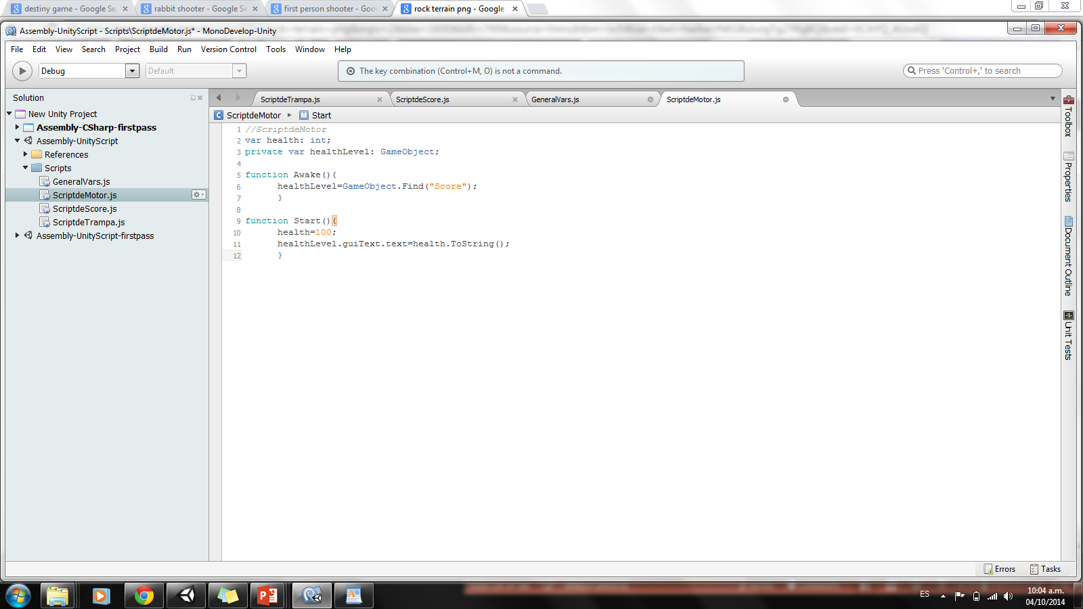
GeneralVars
//GeneralVars.js
static var nSalud : int = 100;
ScriptdeMotor
//ScriptdeMotor
var health: int;
private var healthLevel: GameObject;
function Awake(){
healthLevel=GameObject.Find("Score");
}
function Start(){
health=100;
healthLevel.guiText.text=health.ToString();
}

Slide 10
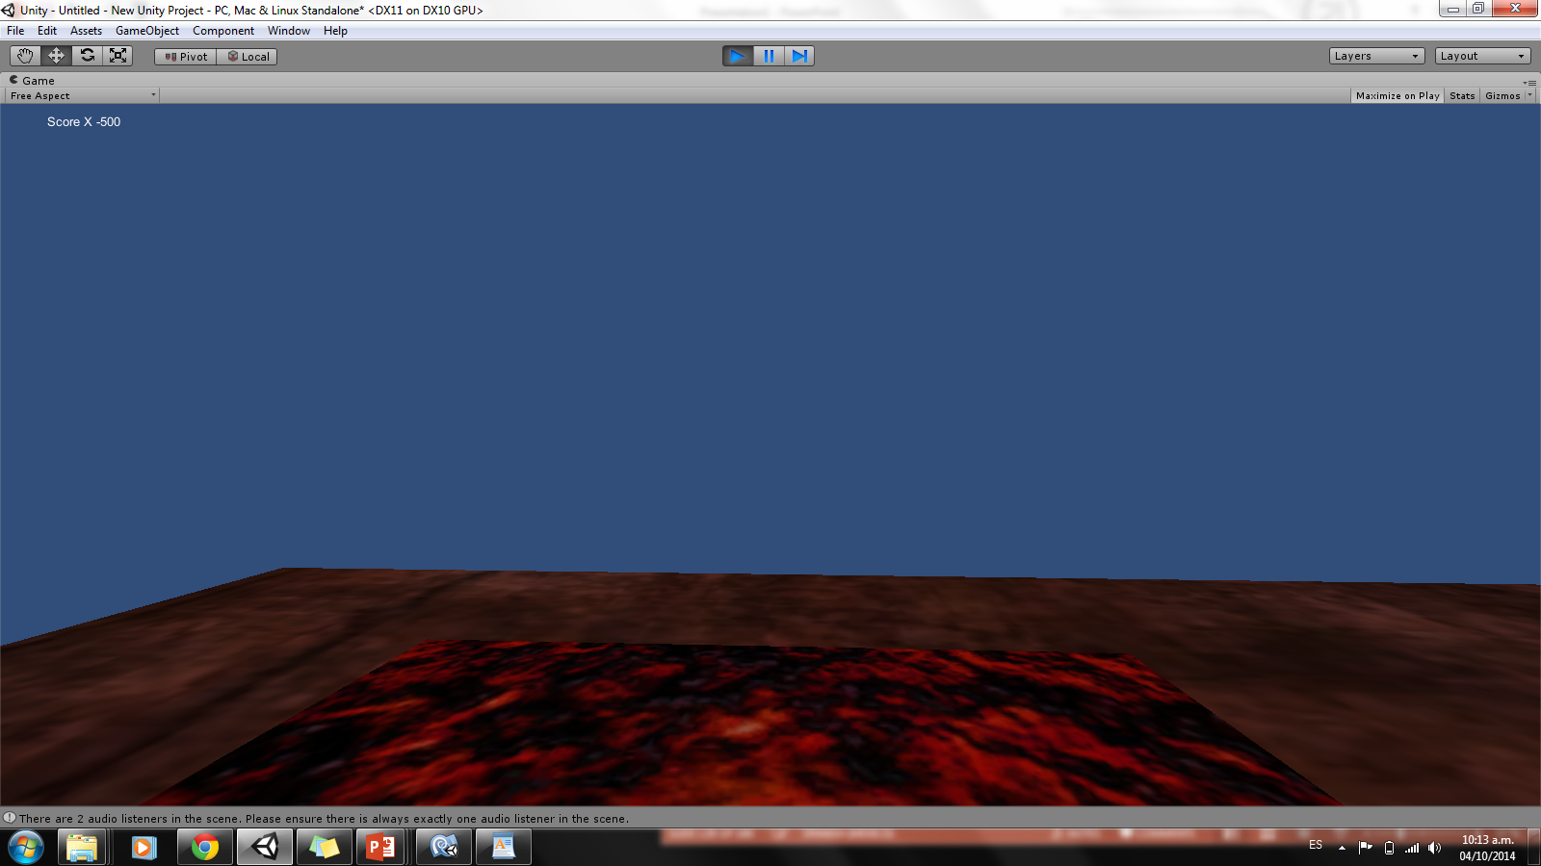

Slide 11
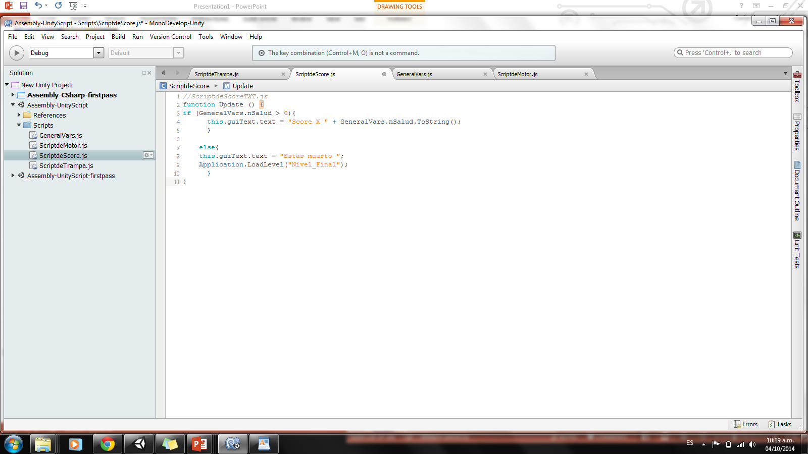
ScriptdeScore
//ScriptdeScoreTXT.js
function Update () {
if (GeneralVars.nSalud > 0){
this.guiText.text = "Score X " + GeneralVars.nSalud.ToString();
}
else{
this.guiText.text = "Estas muerto ";
Application.LoadLevel("Nivel_Final");
}
}

Slide 12
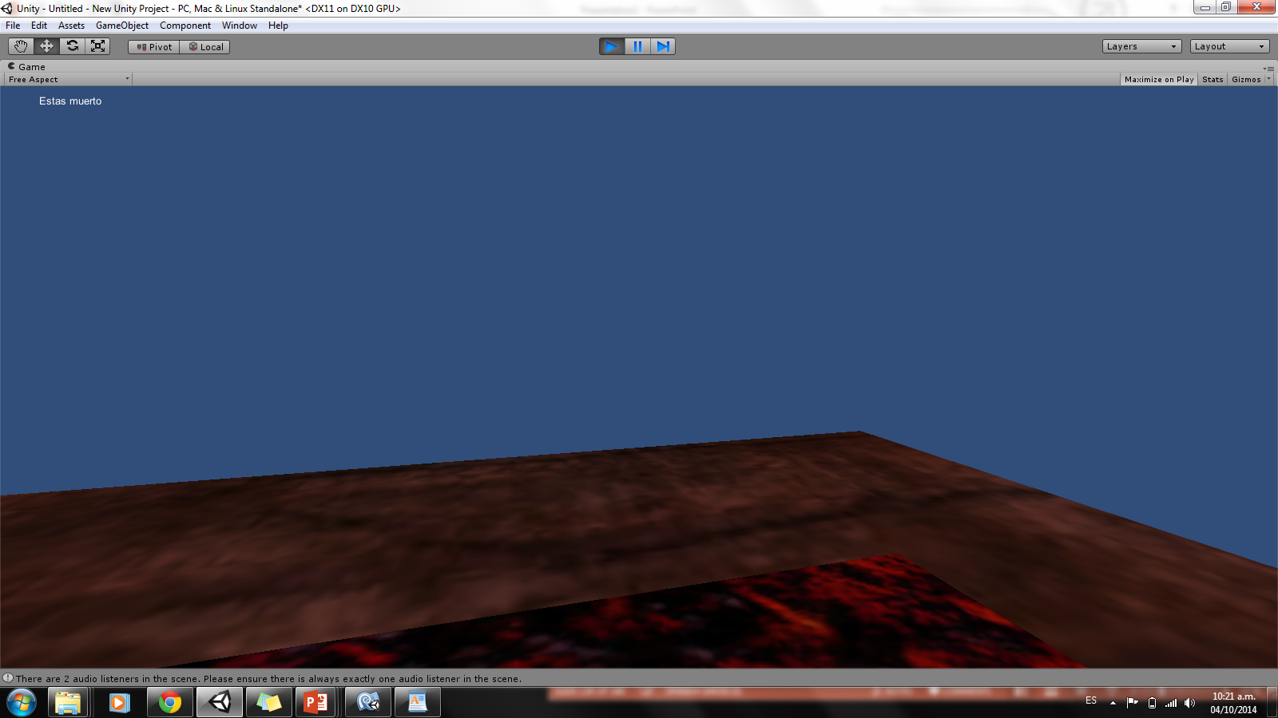

Slide 13
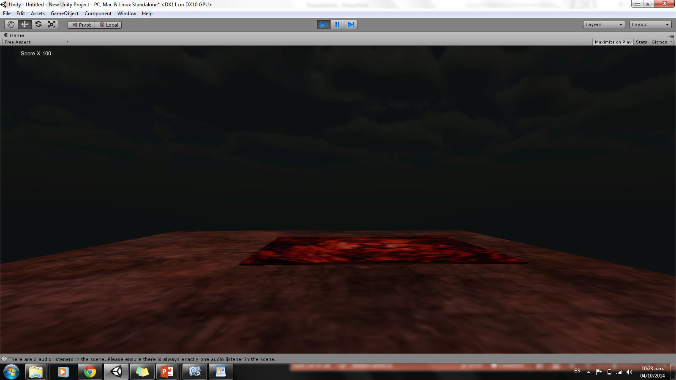

Slide 14
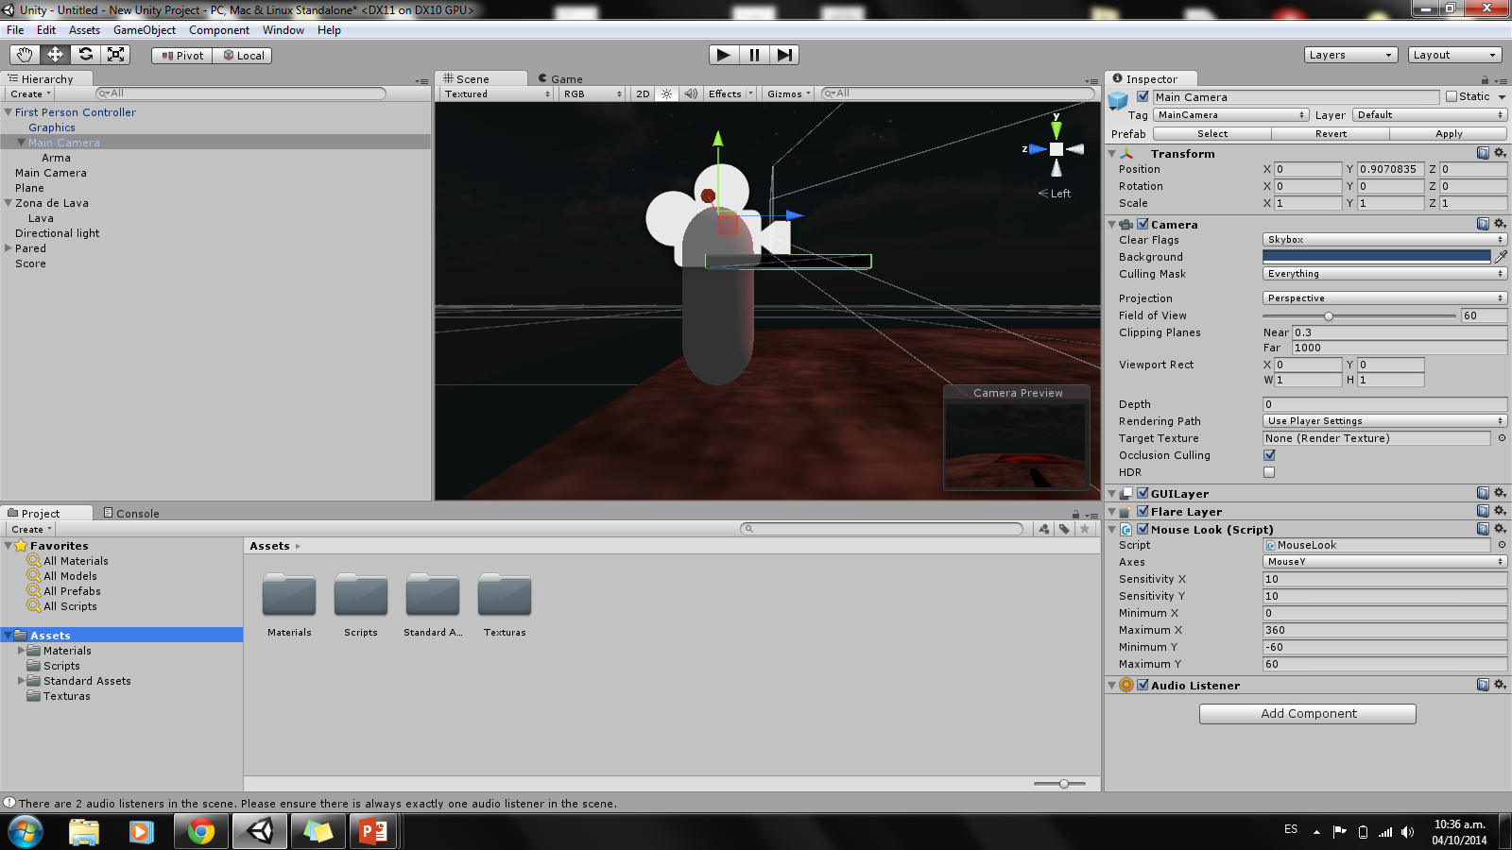
CREAR UN ARMA SIMPLE

Slide 15
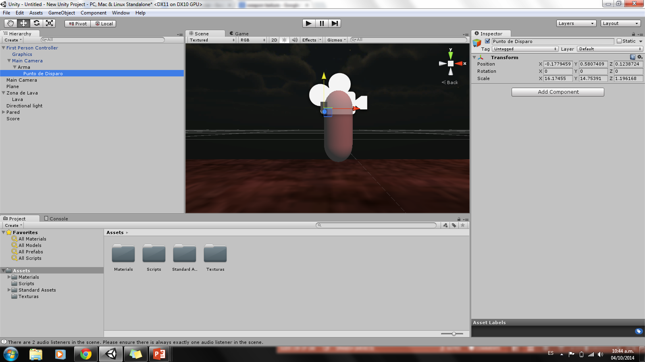
CREAR UN Punto de disparo
(Create Empty)

Slide 16
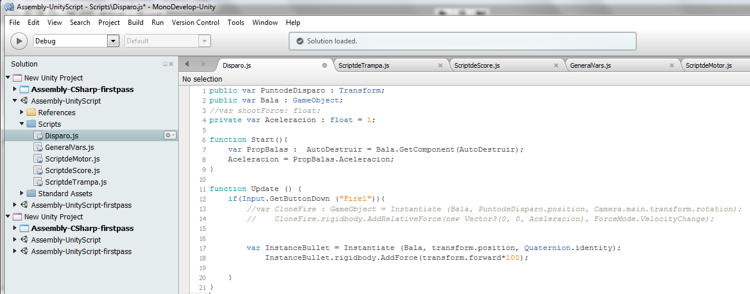
Disparo.js
//Disparo.js
var Bala : Rigidbody;
var speed = 100;
function Update () {
if ( Input.GetButton ("Fire1")) {
clone = Instantiate(Bala, transform.position, transform.rotation);
clone.velocity = transform.TransformDirection( Vector3 (0, 0, speed));
Destroy (clone.gameObject, 1);
}
}

Slide 17
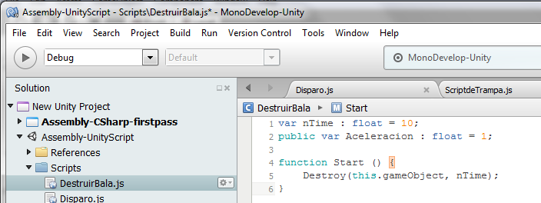
AutoDestruir.js
//Autodestruir.js
var nTime : float = 10;
public var Aceleracion : float = 1;
function Start () {
Destroy(this.gameObject, nTime);
}

Slide 18
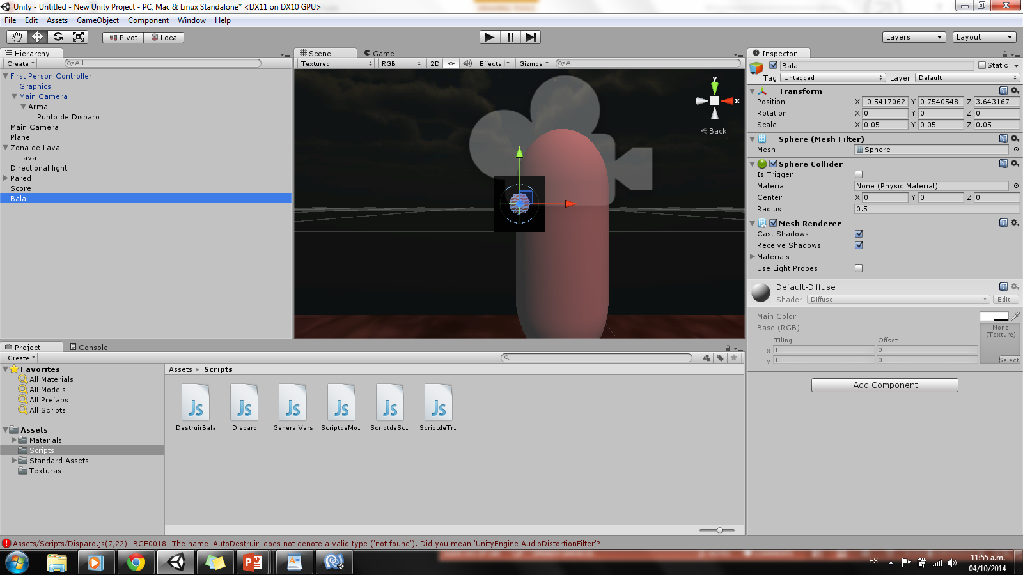
CREAR una Bala
(Sphere)

Slide 19
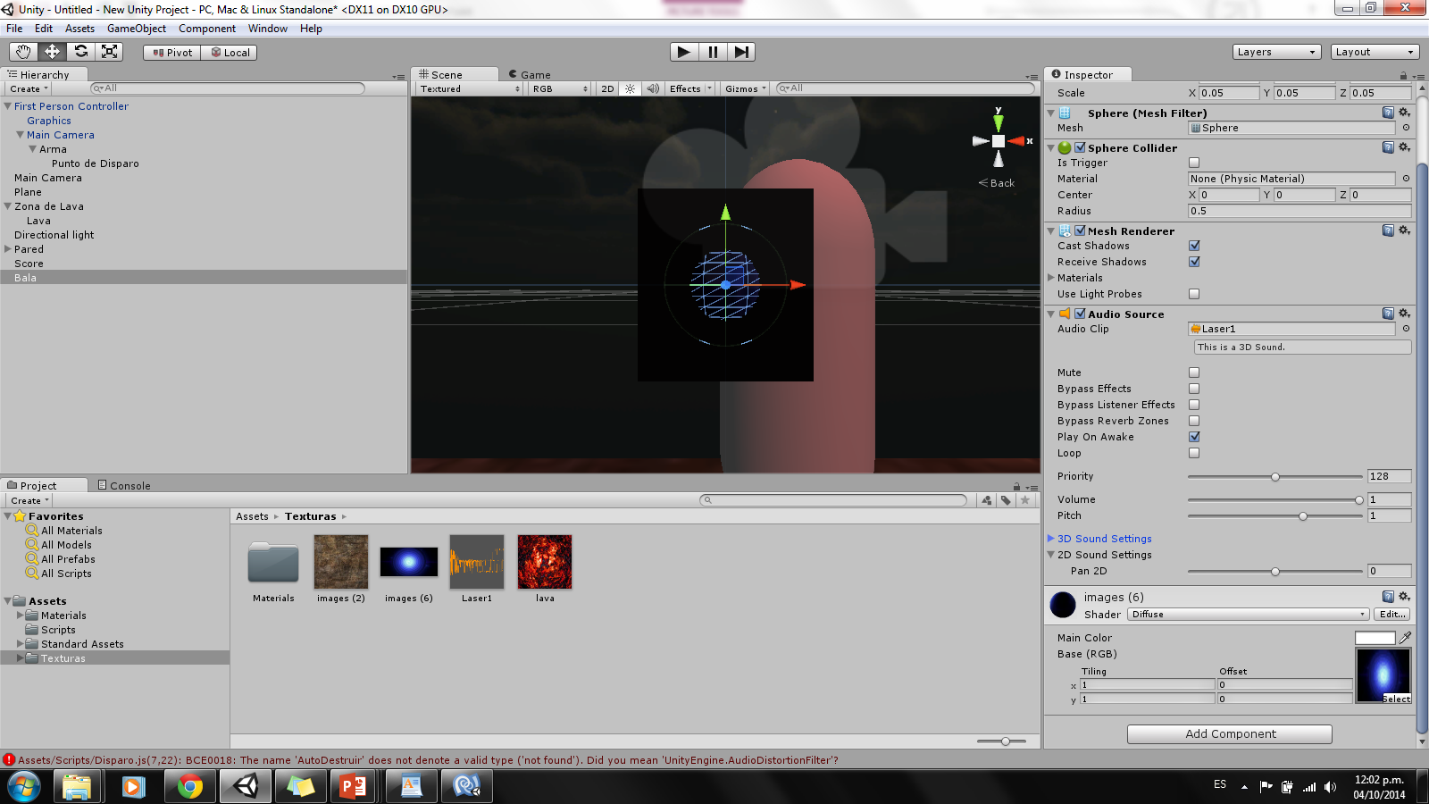
Agregar textura y sonido a Bala

Slide 20
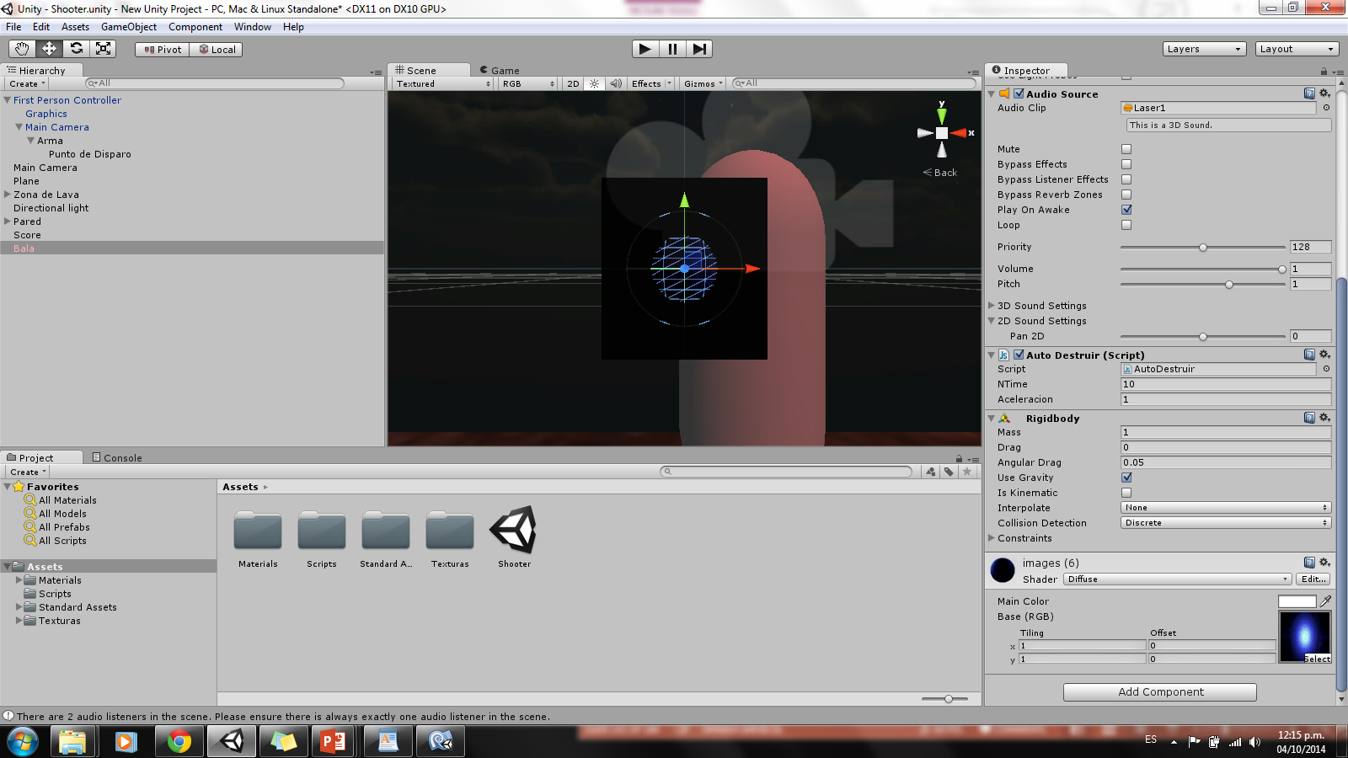

Slide 21
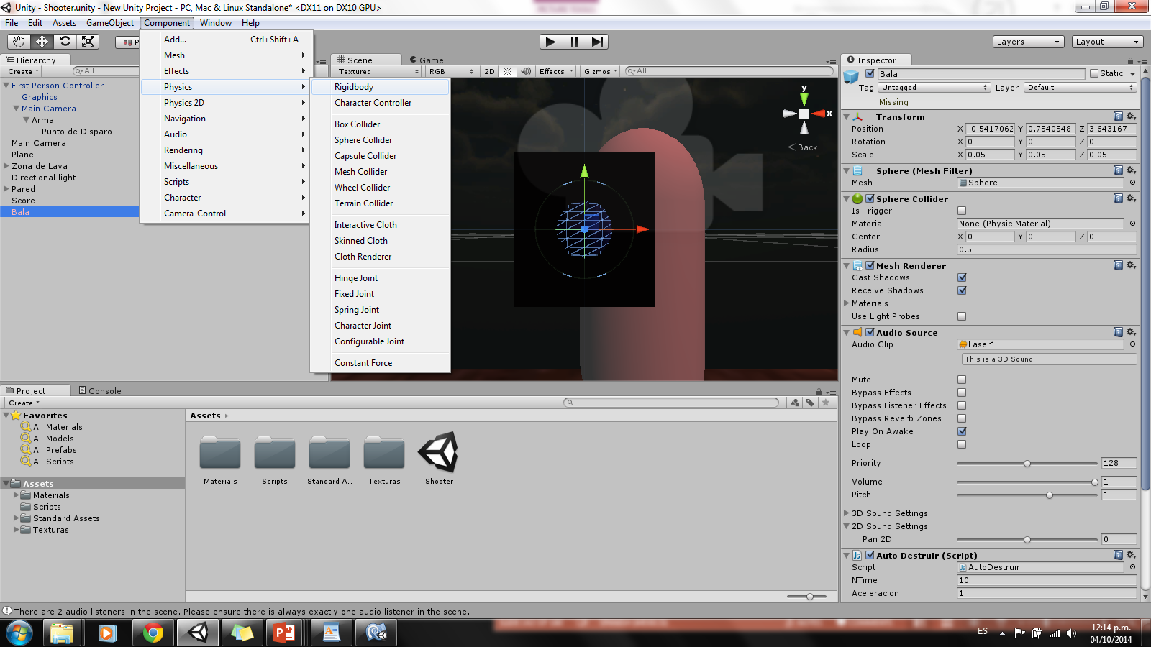

Slide 22
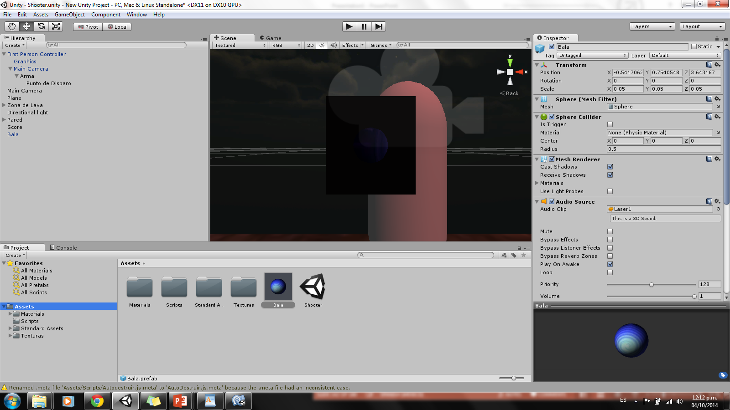

Slide 23
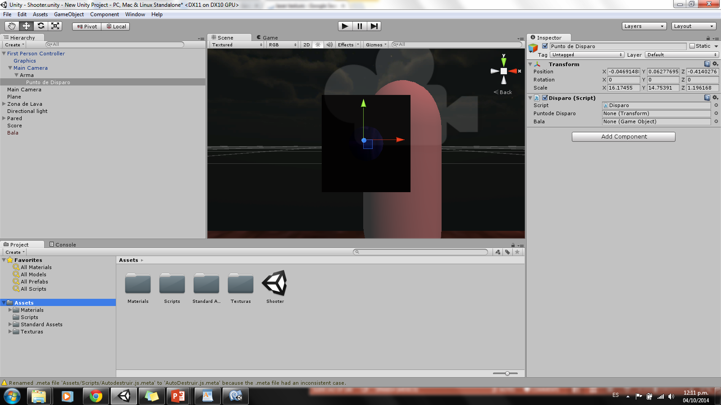

Slide 24
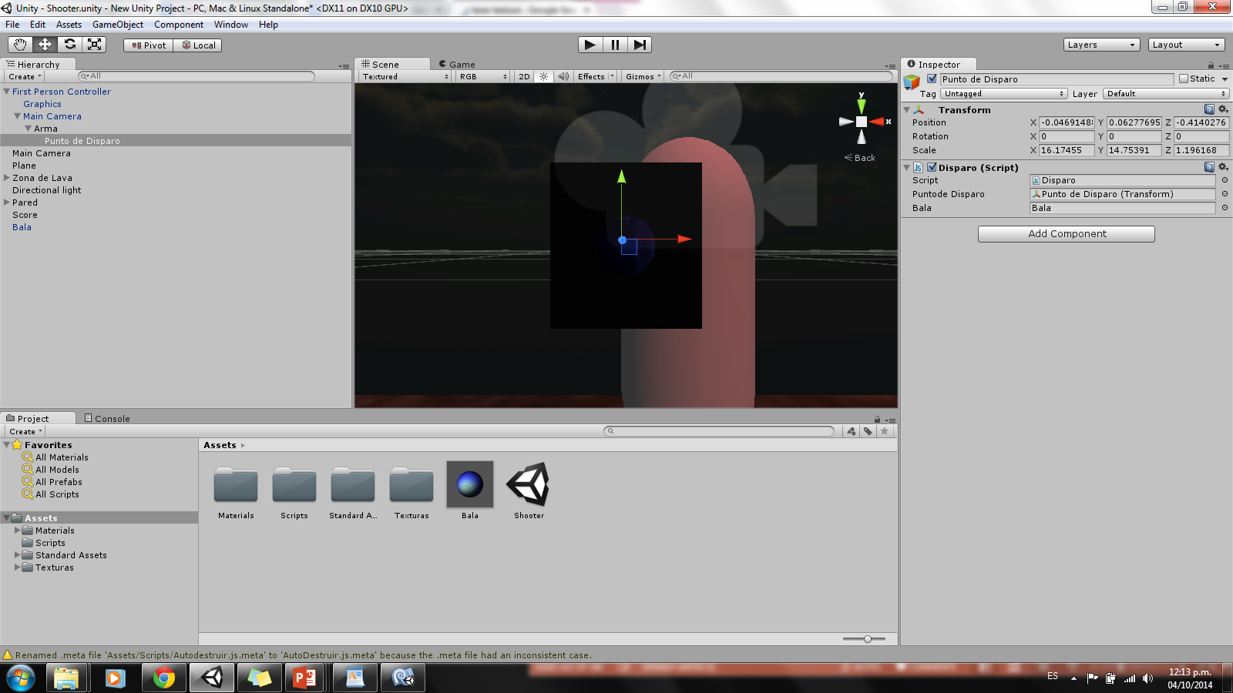

Slide 25
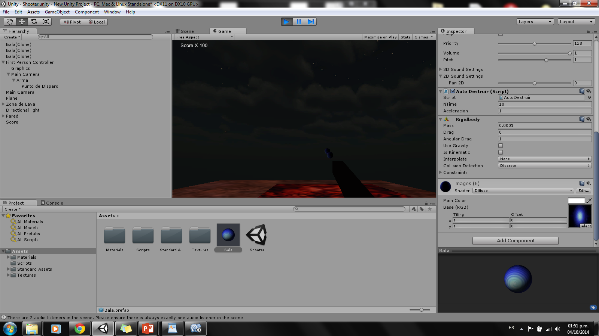

Slide 26
